Slide 1

Marginal utility – real estate Use Case
Property asset value due to additions/ renovations
Sovik Kumar Nath

Slide 2
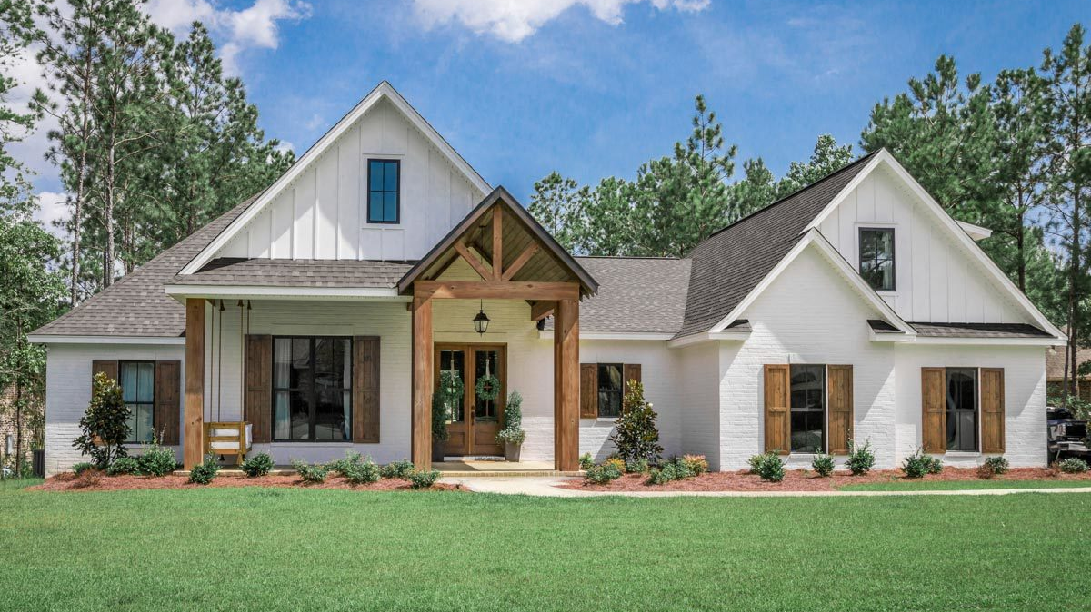
What are the findings Estimated Asset Value for Selected Property for addition
Scoring for 1 Bedroom/ 1 Bathroom addition

Slide 3
Property Value Estimates
Increase in size (sq.ft.) of 1 Bedroom increases the predicted AVM($); However AVM change reduces as size increases though cost increases steadily
Target Property Zipcode : 923736604
Max property price in neighborhood (zip 923736600-923736610) : 720300
Scenario: Addition of 1 Bedroom Outside
Sensitivity Analysis : Bedroom size (25 – 500 Sq.Ft.)
Building to Lot size ratio after addition : 17.5- 22.1%
AVM change decreases for cost as size of bedroom increases; thereby reduced return
Optimal Bedroom size :
100, 175 – 225 sq.ft.
Value : $469k, $477k - $487k
Determined based on AVM increase, AVM increase per cost and usability

Slide 4
Property Value Estimates
Increase in size (sq.ft.) of 1 Bathroom increases the predicted AVM($); However AVM change reduces with major drop as size increases though cost increases steadily
Target Property Zipcode : 923736604
Max property price in neighborhood (zip 923736600-923736610) : 720300
Scenario: Addition of 1 Bathroom Outside
Sensitivity Analysis : Bathroom size (10 – 200 Sq.Ft.)
Building to Lot size ratio after addition : 17.5- 19.3%
Optimal Bathroom size :
10 – 40 sq.ft.
Value : $458k - $465k
Determined based on AVM increase, AVM increase per cost and usability

Slide 5
Property Value Estimates
Increase in size (sq.ft.) of 1 Bedroom - 1 Bathroom increases the predicted AVM($) in steps; However AVM change reduces with major drop as size increases though cost increases stepwise
Target Property Zipcode : 923736604
Max property price in neighborhood (zip 923736600-923736610) : 720300
Scenario: Addition of 1 Bedroom + 1 Bathroom, Outside
Sensitivity Analysis : Bedroom size (25 – 500 Sq.Ft.) Bathroom size (10 – 200 Sq.Ft.)
Building to Lot size ratio after addition : 17.5- 24%
Optimal Bedroom size : 75 – 100 sq.ft.
Optimal Bathroom size : 10 – 40 sq.ft.
Value : $481k - $487k
Determined based on AVM increase, AVM increase per cost and usability

Slide 6
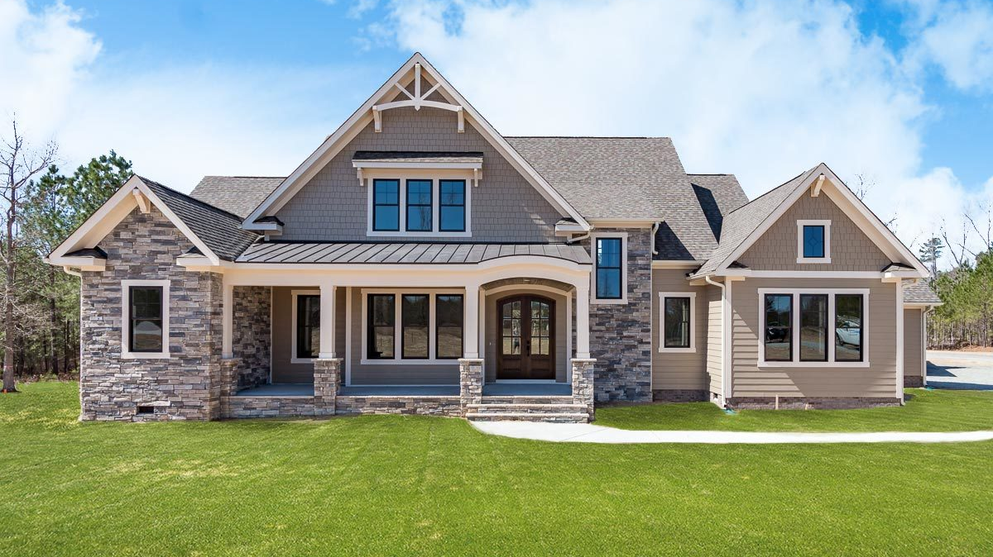
What are the Steps Methodology
Scenarios, Constraints, Steps, Models

Slide 7
Possible Addition Scenarios
1 Bedroom |  | Outside
1 Bedroom |  | Inside (Anywhere)
1 Bedroom |  | Inside (Upper Floor)
 | 1 Bathroom | Outside
 | 1 Bathroom | Inside (Anywhere)
 | 1 Bathroom | Inside (Upper Floor)
1 Bedroom | 1 Bathroom | Outside
1 Bedroom | 1 Bathroom | Inside (Anywhere)
1 Bedroom | 1 Bathroom | Inside (Mixed Floor)
1 bedr
1 bedr
Constraints
Maximum Development = 25 – 35 % of Lot size
Cannot be most expensive home in neighborhood (defined by zip code XXXXX-XX-00)
Build cost = $180 per sq. ft.
Addition :
1 Bedroom Outside
Addition :
1 Bedroom Inside
Highlighted scenarios are scored for AVM estimates
Highlighted scenarios increase built area and building square foot
Internal alteration will not change build area but changes area of room types
Example Scenarios

Slide 8
Steps - Methodology
Data Ingest
+
Data Transform
Segmentation
Model
Training
Model
Scoring
Data Engineering
Model Development
Model Deployment
Data Ingest – Redlands, CA property data with AVM_value_amount
Data process
Data Transform
Dataset : Redlands, CA Single Family House
Build a model to predict AVM_value_amount based on different predictors from dataset
Applying trained model to score – predict the AVM_value_amount for selected property based on scenarios
Quantify Scenarios
Perform Sensitivity analysis – Future AVM, AVM change vs. Cost to build
Segmentation by City/ Location
AVM as function of different parameters
Model training
Hyper-parameter tuning for optimal model performance

Slide 9
Model Development
Based on the GBM Model (universal)_building_square_feet has highest influence on AVM → Therefore new addition outside (leading to new built-up area) will have higher impact on AVM compared to alteration inside the building.
Target Variable : AVM_value_amount → Function of different predictors
Model : Regression trees with Gradient Boosting (GBM in R)
Hyperparameter tuning : Grid-based to obtain optimal model
Model Performance : RMSE

Slide 10
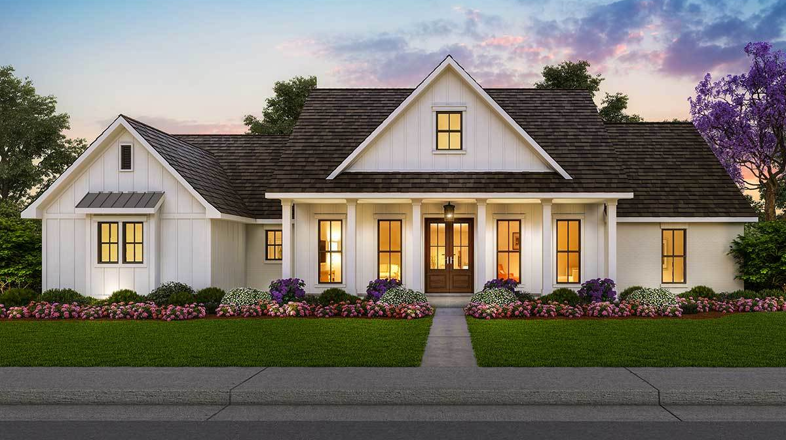
What’s Next
Recommendations and Improvements for future

Slide 11
Scaling – Productizing Models – End-to-End Platform
INGEST DATA
PROCESS DATA
MODEL INPUT
MODEL
OUTPUT
UI – Web Applications
Production data
Data Transformation
Include data features
Predictive Scoring Model
D
C
C
Input data
(transformed and features)
C
Model Output
D
D
Model Performance Monitoring
PRODUCTION
C
DEVELOPMENT
Feature Repository
- Model + Feature Versions
C
Model Repository
C
Development Data
Data Transformation
Feature Generation/ Engineering
Model Training
Model Testing and Validation
D
C
C
Input data
(transformed and features)
C
C
D
Packages
Versions
Model performance
D
D
DATA – In Storage (Data lake) &/ Databases
Retraining
C
C
CODE – Runs on Compute/ Cluster

Slide 12
Recommendations and Improvements for Future
Modular architecture throughout – Data Engineering and Management, Model Training and Development, Model Deployment and Scoring, Model monitoring and governance
Module interactivity - Individual modules works independently connected by data input – data output to other modules
Scaling to other cities – Segmentation by cities and locations and city specific separate models; city specific data repository in data-lake
Model performance improvement – More training, Ensemble techniques and comparison of model performance of different models, segmented models, exhaustive hyper-parameter tuning to create the scoring model
Additional data for features/ model improvement – Historic property-specific transaction, valuation, innovations data; property type (single family, multi-family, townhouse, condo, commercial); over-all market data (e.g. Case-Shiller Index) and market fluctuations; Location/neighborhood specific information (new development, gentrification, school district etc.); Government incentives
Model monitoring – To assess model performance change and covariate shift in data and re-train model accordingly

Slide 13
